Slide 1
Data Cleaning, Manipulation and Wrangling using pandas and sklearn Libraries in python
Dr. Rakhee Chhibber

Slide 2
Data & Math Foundations
Math + Data Handling + Examples

Slide 3
Why Linear Algebra in AI?
Core of ML algorithms
Used in embeddings, CNNs, transformers
Optimization uses matrix calculus

Slide 4
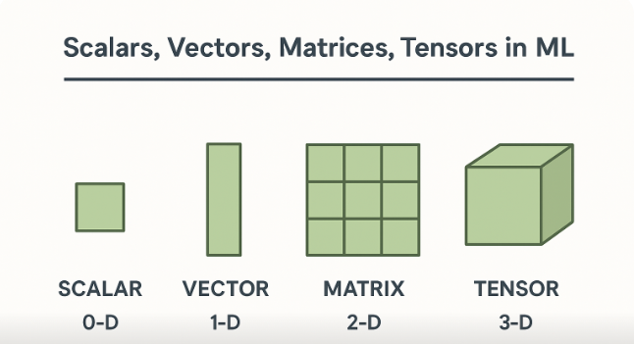

Slide 5
Tensors
Scalars, Vectors, Matrices, Tensors
Scalar: single value
Vector: 1D array
Matrix: 2D
Tensor: multi-dimensional

Slide 6
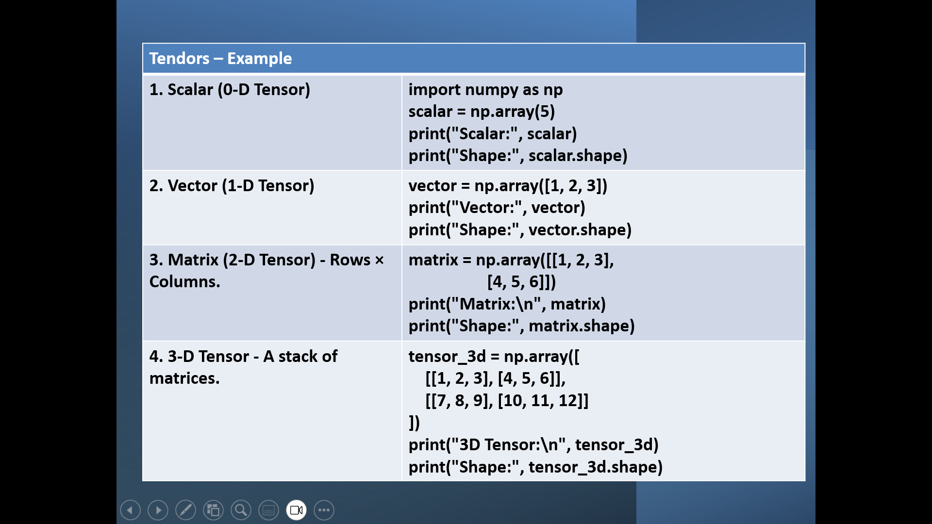

Slide 7
Vector Operations
Addition & subtraction
Dot product
Cosine similarity
Magnitude

Slide 8
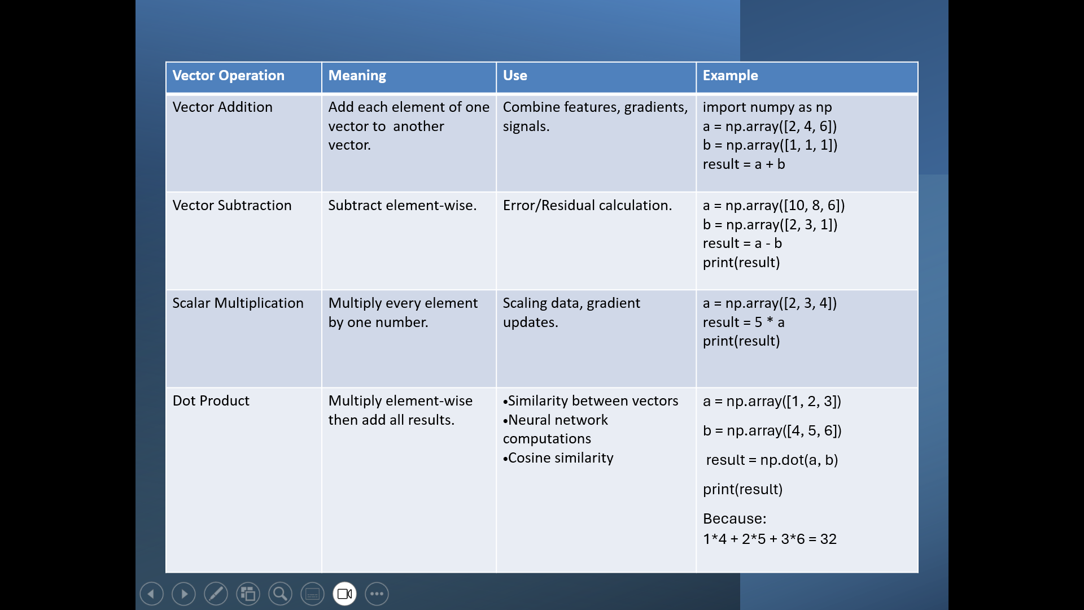

Slide 9
Matrix Operations
Addition & multiplication
Transpose
Inverse
Identity matrix

Slide 10
Matrix Operations in ML
import numpy as np A = np.array([[1, 2], [3, 4]]) B = np.array([[5, 6], [7, 8]])
1. Matrix Addition | print(A + B) | [[ 6 8] [10 12]]
2. Matrix Subtraction | Print(A - B ) | [[-4 -4] [-4 -4]]
3. Matrix Multiplication (Dot Product) | Print(A @ B ) | [[19 22] [43 50]]
4. Element-wise Multiplication | Print(A * B) | [[ 5 12] [21 32]]
5. Matrix Division (Element-wise) | Print( A / B ) | [[0.2 0.33333333] [0.42857143 0.5 ]]
6. Scalar Multiplication | Print( 3 * A ) | [[ 3 6] [ 9 12]]
7. Matrix Transpose | Print(A.T) | [[1 3] [2 4]]
8. Matrix Determinant | Print()np.linalg.det(A) | -2.0000000000000004
9. Matrix Rank | Print(np.linalg.matrix_rank(A) | 2
10. Matrix Inverse | Print(np.linalg.inv(A)) | [[-2. 1. ] [ 1.5 -0.5]]

Slide 11
Matrix Operations in ML
import numpy as np A = np.array([[1, 2], [3, 4]]) B = np.array([[5, 6], [7, 8]])
11. Eigenvalues & Eigenvectors | vals, vecs = np.linalg.eig(A); Print(vals, vecs) | [-0.37228132 5.37228132]
12. Matrix Concatenation (Horizontal) | Print(np.hstack((A, B))) | [[1 2 5 6] [3 4 7 8]]
13. Matrix Concatenation (Vertical) | Print(np.vstack((A, B)) ) | [[1 2] [3 4] [5 6] [7 8]]
14. Matrix Reshape | Print(A.reshape(4,1) ) | [[1] [2] [3] [4]]
15. Matrix Norm | Print( np.linalg.norm(A) ) | 5.477225575051661
16. Power (Element-wise Power) | Print(A**2 ) | [[ 1 4] [ 9 16]]
17. Identity Matrix | Print( np.eye(2)) | [[1. 0.] [0. 1.]]

Slide 12
Data Cleaning
1. Handling Missing Values
2. Removing Duplicates
3. Handling Outliers
4. Encoding Categorical Variables
5. Scaling Numerical Features
6. Converting Data Types
7. Feature Extraction (Sklearn)
8. Removing Unnecessary Columns
9. Handling Imbalanced Data (sklearn)

Slide 13
Missing Values
Missing value can be treated
Using pandas
Using scikit learn

Slide 14
Missing Values
import pandas as pd
import numpy as np
df = pd.DataFrame({
'age': [25, np.nan, 35, 40],
'salary': [50000, 60000, np.nan, 80000]
})
# Fill missing values
df['age'] = df['age'].fillna(df['age'].mean())
df['salary'] = df['salary'].fillna(df['salary'].median())
print(df)
from sklearn.impute import SimpleImputer
import numpy as np
imp = SimpleImputer(strategy='mean') # or 'median', 'most_frequent'
cleaned = imp.fit_transform(df)
print(cleaned)

Slide 15
Removing Duplicates
df = df.drop_duplicates()
df['age'] = df['age'].astype(int)

Slide 16
Encoding Categorical Variables
Using Pandas — One-Hot Encoding
df = pd.DataFrame({
'city': ['Delhi', 'Mumbai', 'Delhi', 'Chennai']
})
df_encoded = pd.get_dummies(df, columns=['city'])
print(df_encoded)

Slide 17
Scaling Numerical Features
from sklearn.preprocessing import StandardScaler
scaler = StandardScaler()
scaled = scaler.fit_transform(df[['age', 'salary']])
print(scaled)

Slide 18
Data Wrangling
Groupby
Merge
Sort
Pivot

Slide 19
Group By
groupby() is used to split data into groups, apply a function (sum, mean, count, max…), and then combine results.
It is one of the core operations for aggregation, reporting, and summarization.
Use cases:
  Sales summary (sales by region, product, month)
  HR analytics (employees by department, average salary)
  Finance (spend by category, quarter)

Slide 20
Example
import pandas as pd
data = {
'Region': ['East', 'West', 'East', 'North', 'West'],
'Sales': [200, 150, 300, 100, 220],
'Profit': [20, 15, 30, 10, 25]
}
df = pd.DataFrame(data)
df_group = df.groupby('Region')['Sales'].sum()
print(df_group)

Slide 21
PIVOT / PIVOT TABLE
Pivot converts rows → columns to summarize data (Excel-like pivot table).
Most commonly used because it handles duplicates and aggregation.
Use cases:
Monthly sales summary
Region vs Product matrix
HR headcount mapping (Department × Gender)

Slide 22
Example
data = {
'Region': ['East','East','West','West','North'],
'Product': ['A','B','A','B','A'],
'Sales': [200, 250, 300, 100, 120]
}
df = pd.DataFrame(data)
pivot = df.pivot_table(values='Sales', index='Region', columns='Product', aggfunc='sum')
print(pivot)

Slide 23
Feature Engineering
Encoding
Scaling
Date features

Slide 24
Encoding- (Converting categorical data into numeric form)
Machine Learning models work with numbers, so categorical columns (like City, Category, Department) must be encoded.
Label Encoding
One-Hot Encoding
Ordinal Encoding
Frequency Encoding

Slide 25
One-Hot Encoding
Creates dummy columns for each category.
Example:
City = [Delhi, Mumbai] → City_Delhi, City_Mumbai
✔ Best for:
Logistic Regression
Linear Regression
Neural networks
❌ Not recommended for:
Columns with 100+ categories (leads to sparse matrix)
Python Example
pd.get_dummies(df, columns=['City'], drop_first=True)

Slide 26
Scaling-(Normalizing numerical values)
Different features have different ranges (e.g. Salary = 20000 vs Age = 30).
Scaling ensures all features contribute equally.
Standard Scaling (Z-Score Normalization)
Min-Max Scaling (0–1 Normalization)
Robust Scaling

Slide 27
Standard Scaling (Z-Score Normalization)
Converts data to mean = 0, std = 1.
Formula:
x_scaled = (x - mean) / std
✔ Best for:
Linear Regression, Logistic Regression
SVM
Neural Networks
Python
from sklearn.preprocessing import StandardScaler
scaler = StandardScaler()
df['Age_scaled'] = scaler.fit_transform(df[['Age']])

Slide 28
Extract Basic Date Components
df['year'] = df['date'].dt.year
df['month'] = df['date'].dt.month
df['day'] = df['date'].dt.day
df['weekday'] = df['date'].dt.dayofweek
# 0 = Monday
df['week'] = df['date'].dt.isocalendar().week

Slide 29
Business / Seasonal Features
df['is_weekend'] = df['date'].dt.dayofweek >= 5
df['quarter'] = df['date'].dt.quarter
df['is_month_start'] = df['date'].dt.is_month_start
df['is_month_end'] = df['date'].dt.is_month_end

Slide 30
Visualization Concepts- Matplotlib library
Line chart
Bar chart
Histogram
Scatter plot

Slide 31
Visualization Examples
Sales trend
Customer distribution
Scatter analysis

Slide 32
Sales Trend Analysis (Line Plot)
Example Dataset
Purpose:
To see how sales change over time.
Month | Sales
Jan | 12000
Feb | 15000
Mar | 17000
Apr | 14000
May | 19000

Slide 33
import pandas as pd
import matplotlib.pyplot as plt
df = pd.DataFrame({
"Month": ["Jan","Feb","Mar","Apr","May"],
"Sales": [12000,15000,17000,14000,19000]
})
plt.plot(df["Month"], df["Sales"])
plt.title("Sales Trend Over Months")
plt.xlabel("Month")
plt.ylabel("Sales")
plt.show()
Interpretation:
Sales increased from Jan → Mar
Dropped in Apr
Recovered strongly in May

Slide 34
Customer Distribution (Bar Chart / Pie Chart)
Example Dataset
Purpose: -To understand how customers are divided across categories (city, age groups, products).
City | Customers
Delhi | 220
Mumbai | 180
Bangalore | 140
Kolkata | 90

Slide 35
df = pd.DataFrame({
"City": ["Delhi","Mumbai","Bangalore","Kolkata"],
"Customers": [220,180,140,90]
})
plt.bar(df["City"], df["Customers"])
plt.title("Customer Distribution by City")
plt.xlabel("City")
plt.ylabel("Number of Customers")
plt.show()
Interpretation:
Delhi has the highest customer base
Kolkata has the lowest

Slide 36
Scatter Analysis (Relationship Between Variables)
Purpose:
Used to find correlation (positive, negative or none) between two variables.
Example Dataset
Spending (₹) | Number of Orders
2000 | 7
3500 | 12
1500 | 4
4000 | 15
2800 | 8

Slide 37
df = pd.DataFrame({
"Spending": [2000, 3500, 1500, 4000, 2800],
"Orders": [7, 12, 4, 15, 8]
})
plt.scatter(df["Spending"], df["Orders"])
plt.title("Scatter Plot: Spending vs Orders")
plt.xlabel("Customer Spending")
plt.ylabel("Number of Orders")
plt.show()
Interpretation:
Higher spending → more orders
Shows a clear positive correlation

Slide 38

Case Study: Customer Segmentation
Clean data
Analyze patterns

Slide 39

Goal
👉 Clean raw customer data
👉 Perform deep exploratory analysis
👉 Build features
👉 Prepare data for segmentation (e.g., K-Means)
https://colab.research.google.com/drive/1XdFmSMPaOMRY4PTrtFOuvtWbqT2-m1If?authuser=7#scrollTo=uDsv459VkoFQ

Slide 40

Thank You

